Slide 1
International Scout Volunteer Group
(ISVG)
Online course
Covid 19 Pandemic and
Stress Management
Dr. Dikpal Keshari Baidya, D.Sc. (Japan), R.S.W. (Canada)
Toronto, Canada 11

Slide 2
Contents:
1. What is Covid-19?
2. Pandemic vs Epidemic
3. Definition of Stress
4. Good Stress and Bad stress
5. Types of Stress
6. Causes of Stress
7. Stress Management Techniques
Aromatherapy (b) Hydrotherapy (c) Oxytherapy
(d) Visiotherapy (e) Soundtherapy

Slide 3
What is COVID-19 ?
Covid-19 is caused by infection with the severe acute respiratory syndrome coronavirus 2 (SARS-CoV-2) virus strain.
Virus
Virus infect all LIFE FORMS, animals, plants, including microorganisms including bacteria and archaea (organisms lack of defined nucleus).
Virus definition
It is a nuclei acid molecule in a protein coat, able to multiply ONLY WITHIN THE LIVING CELLS OF A HOST.

Slide 4
Pandemic vs Epidemic :
An infectious disease spread around the globe is Pandemic whereas Epidemic is spread around a large population in certain cities.

Slide 5
Stress:
Definition: The body's response to physical and mental pressure, due to the chemical changes in our body (Pituitary & Adrenal glands).
- Behavioral Science

Slide 6
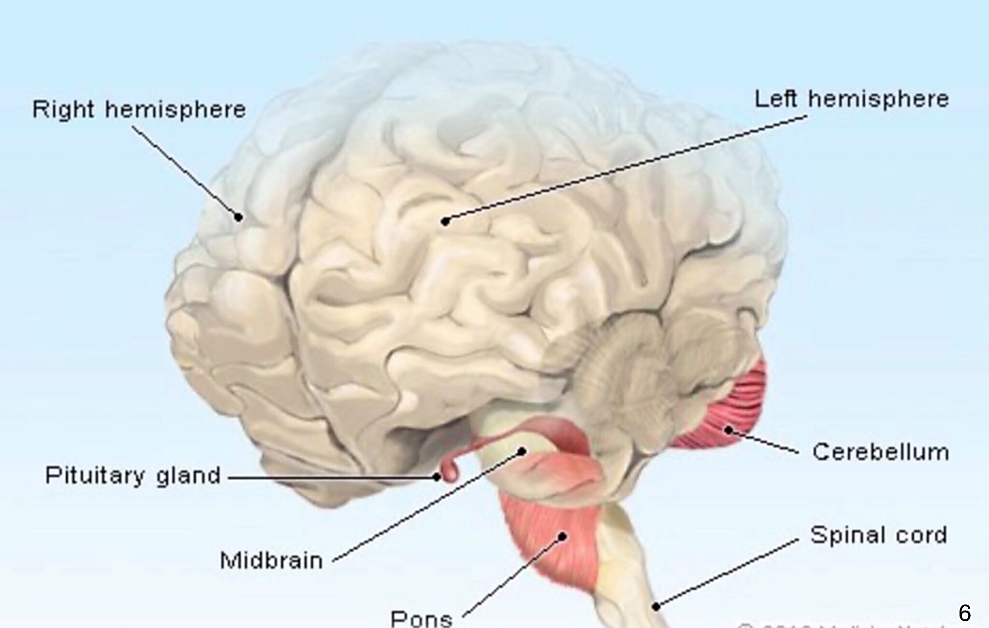

Slide 7
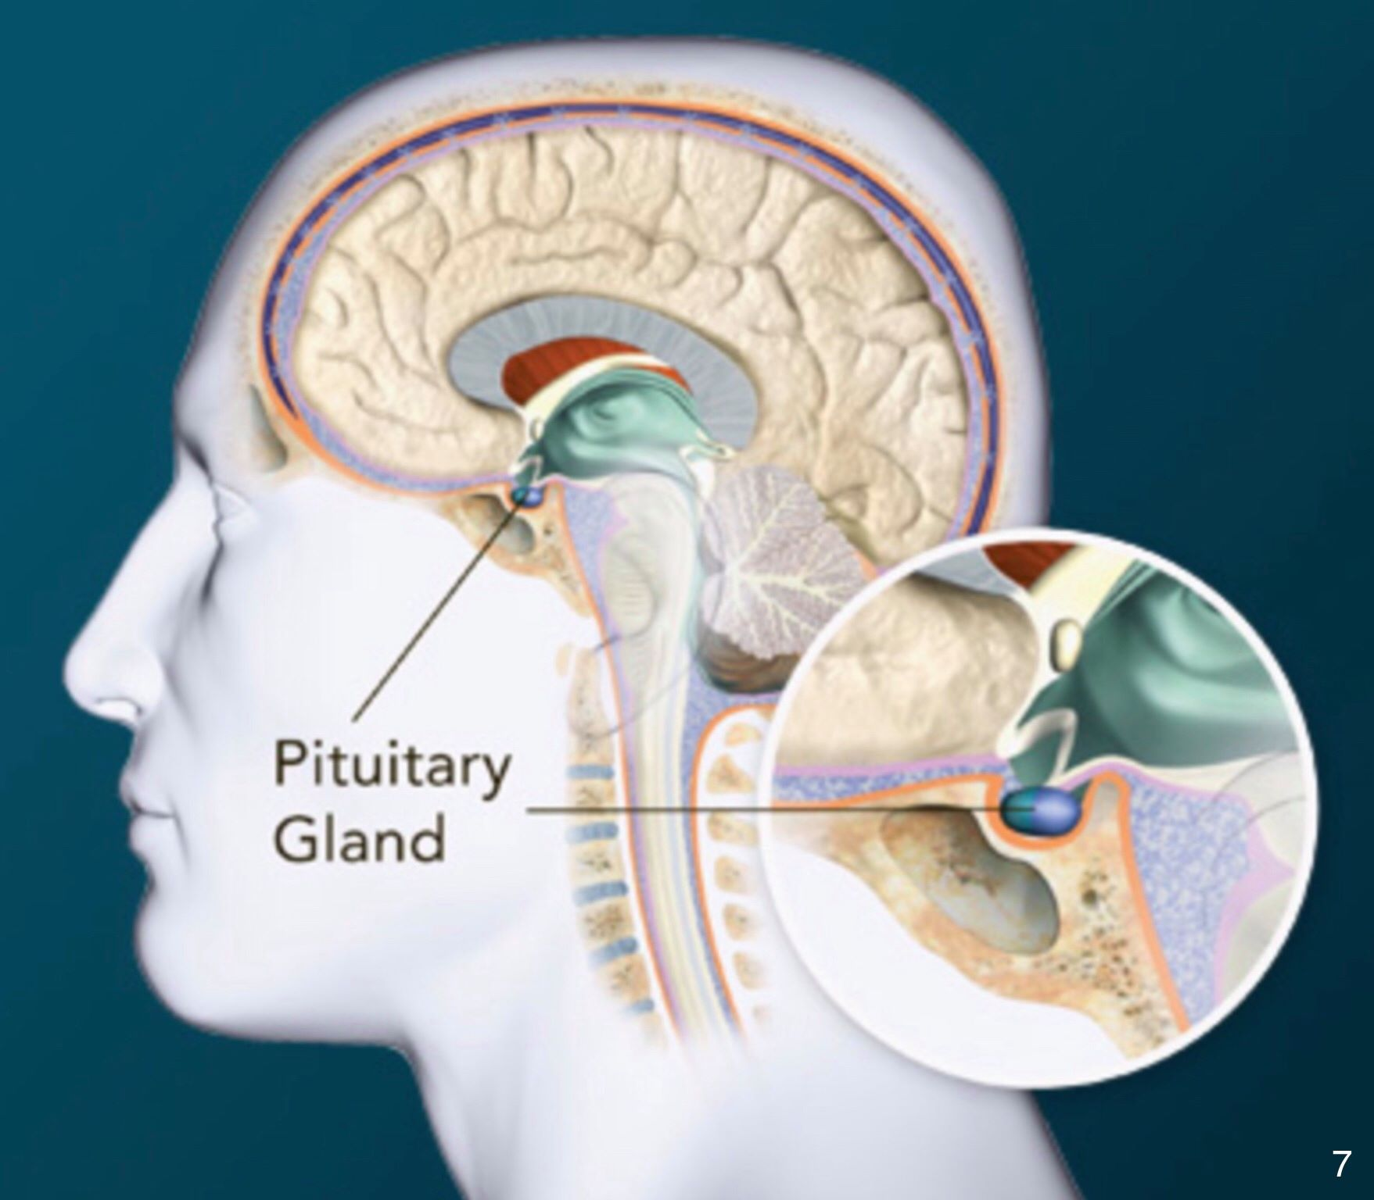

Slide 8
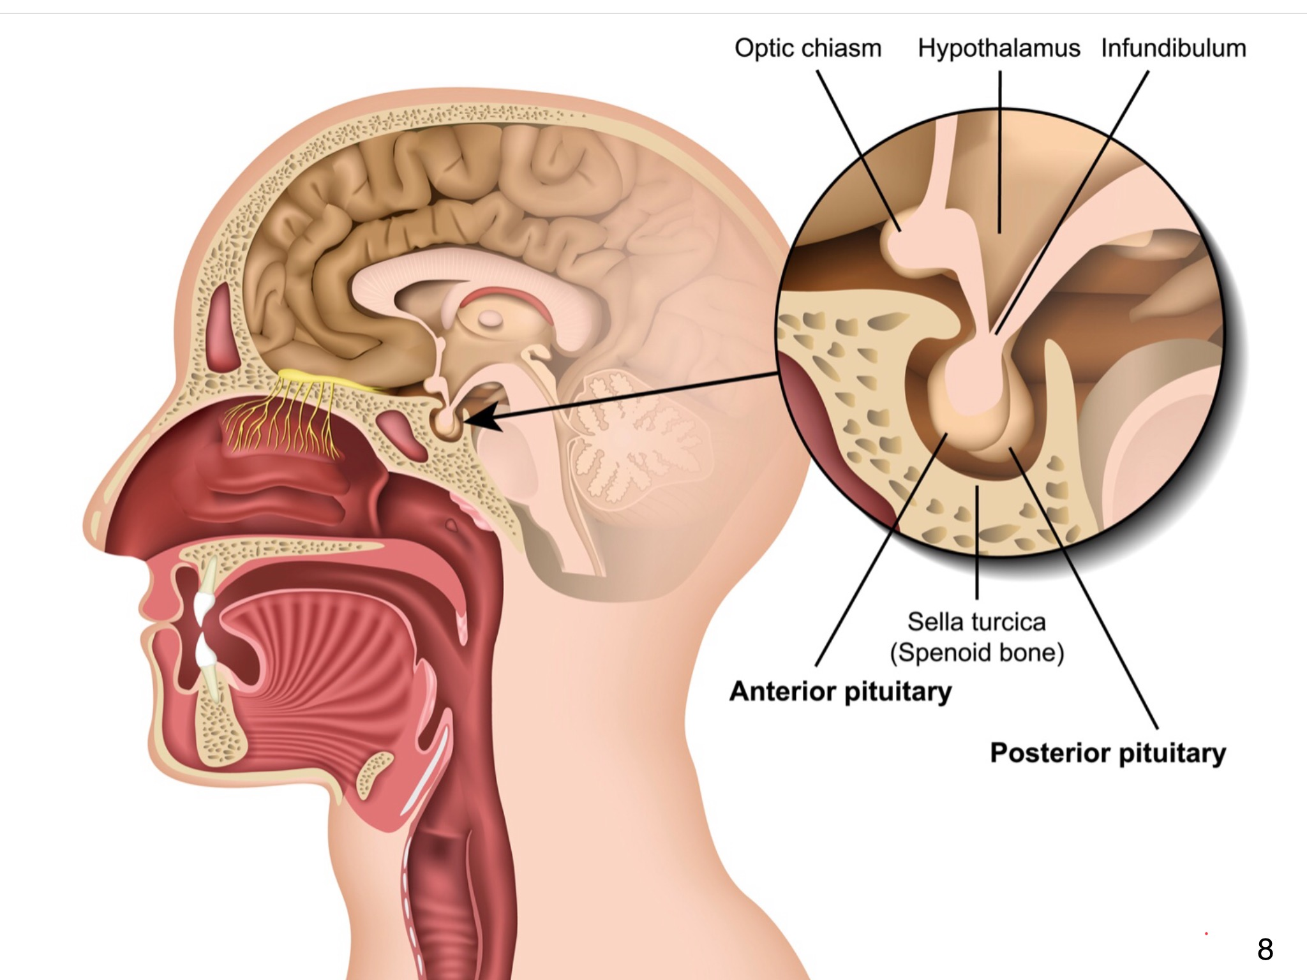

Slide 9
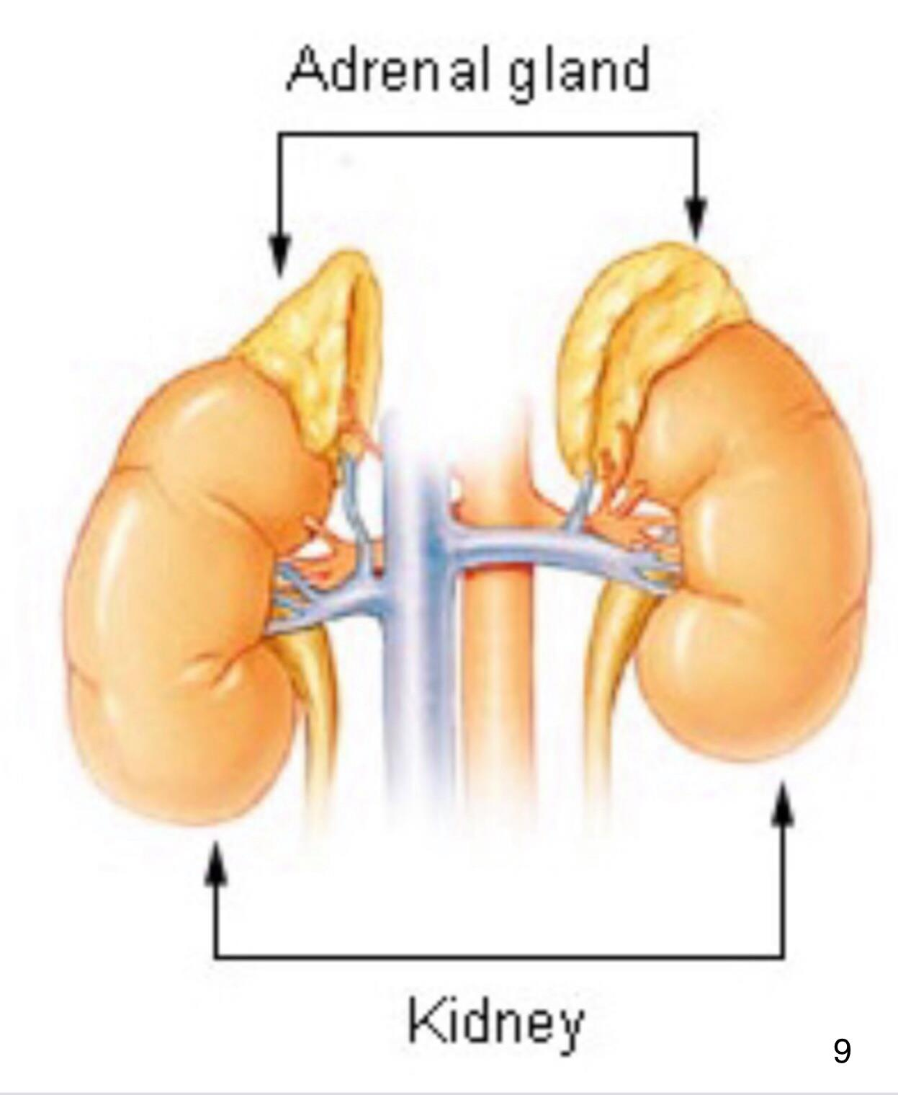

Slide 10
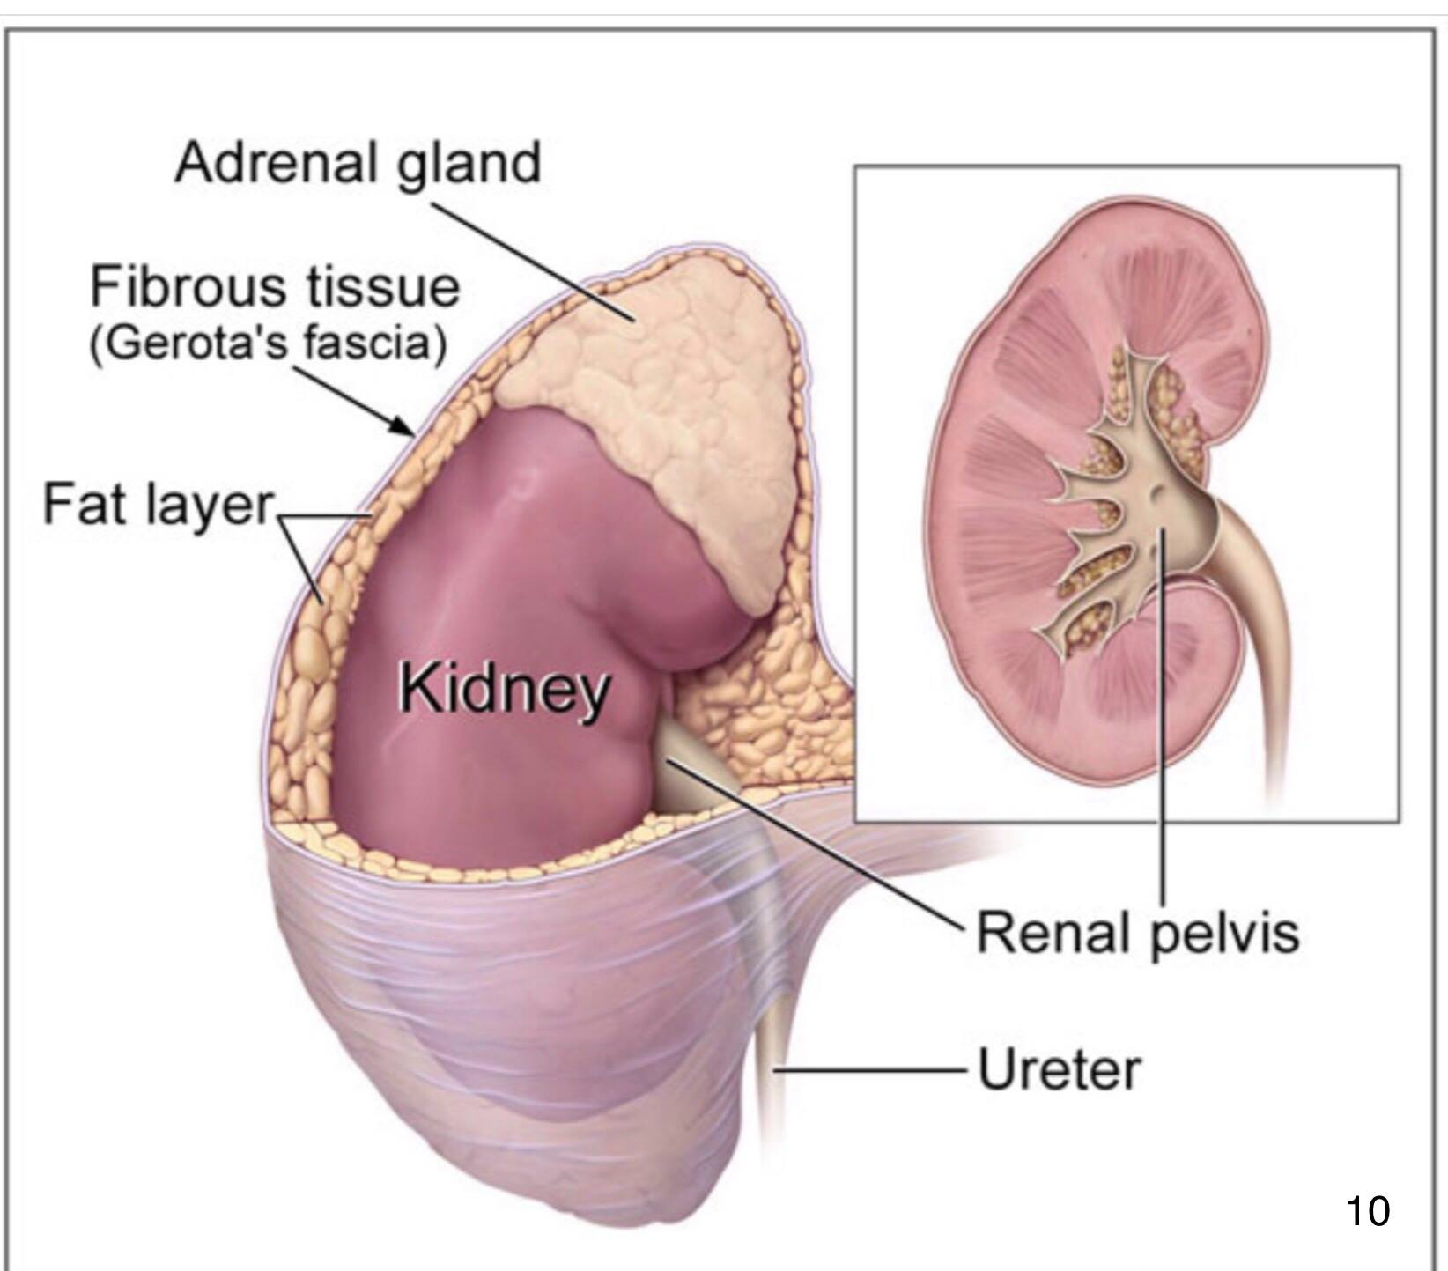

Slide 11
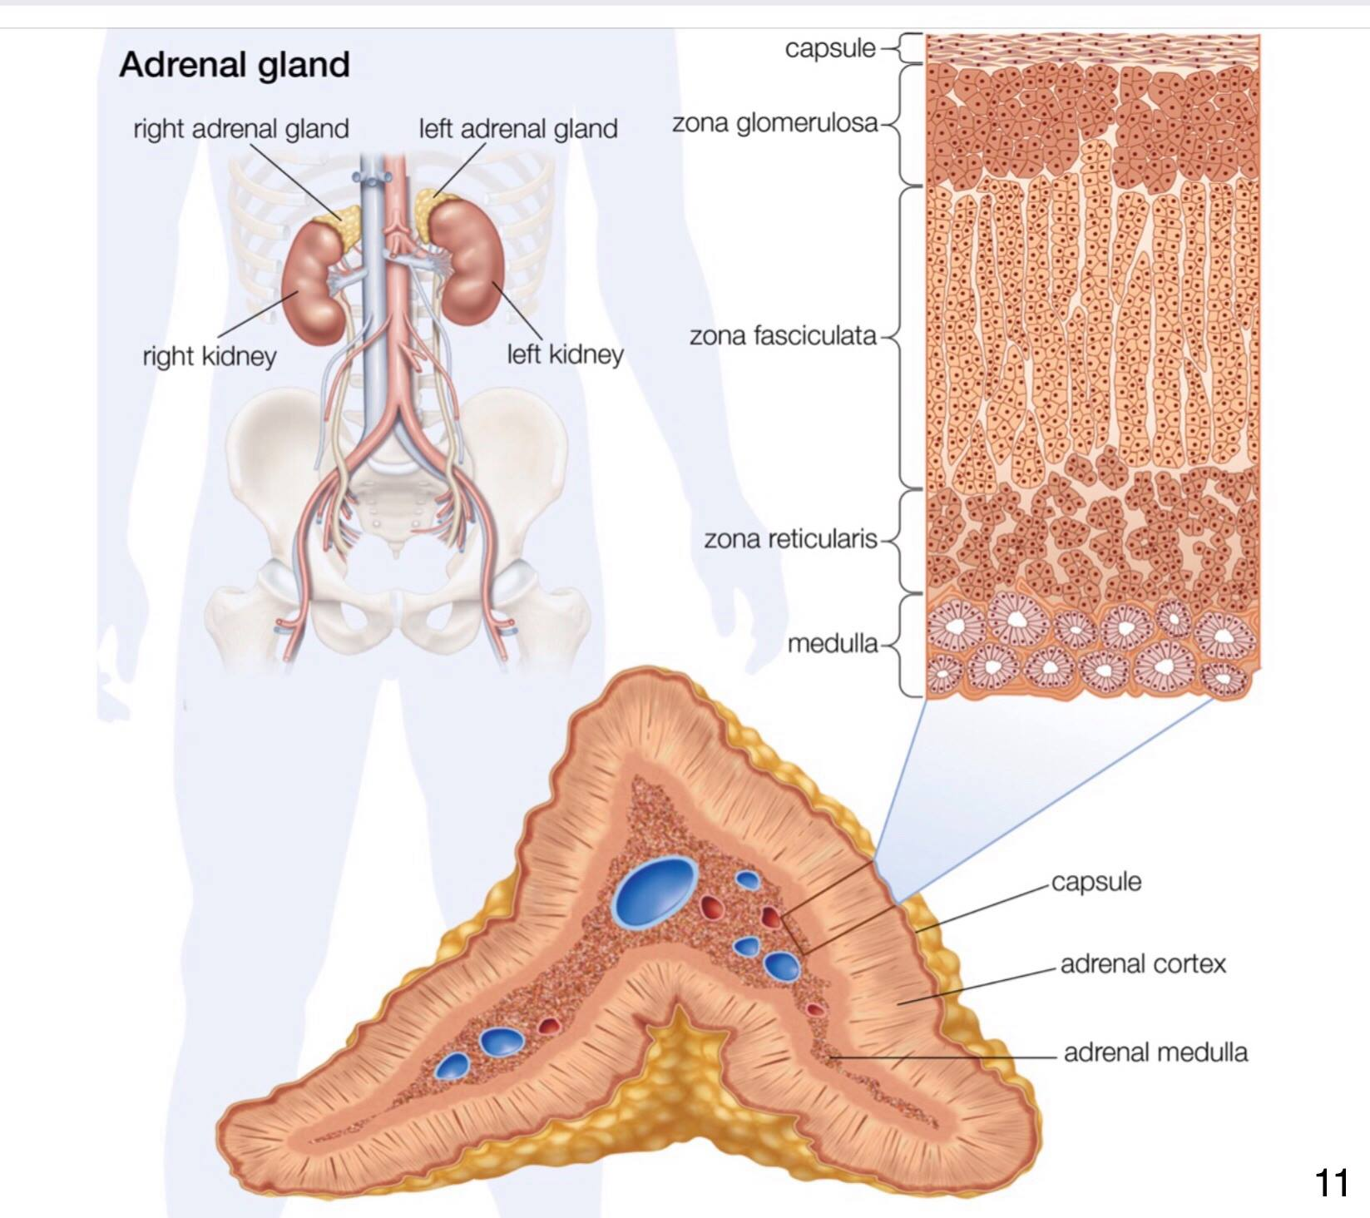

Slide 12
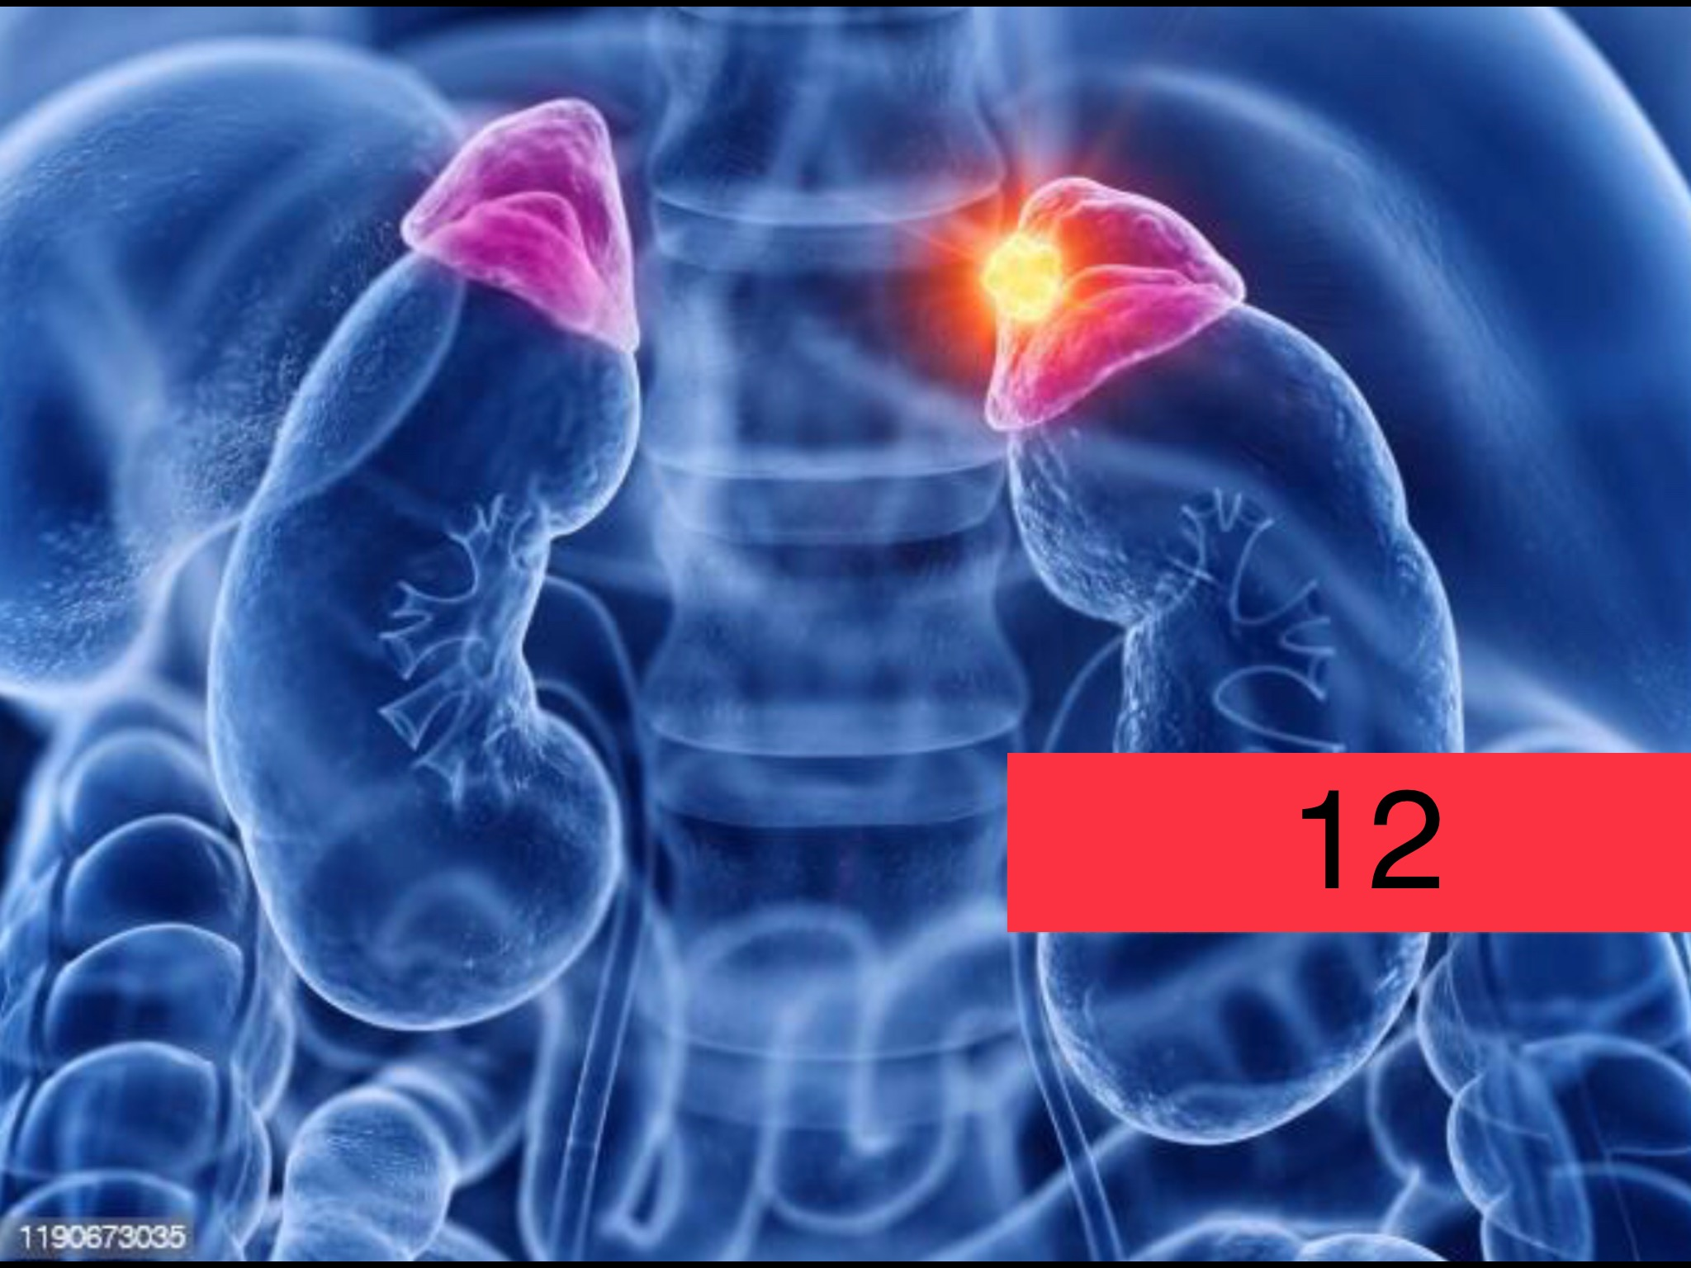

Slide 13
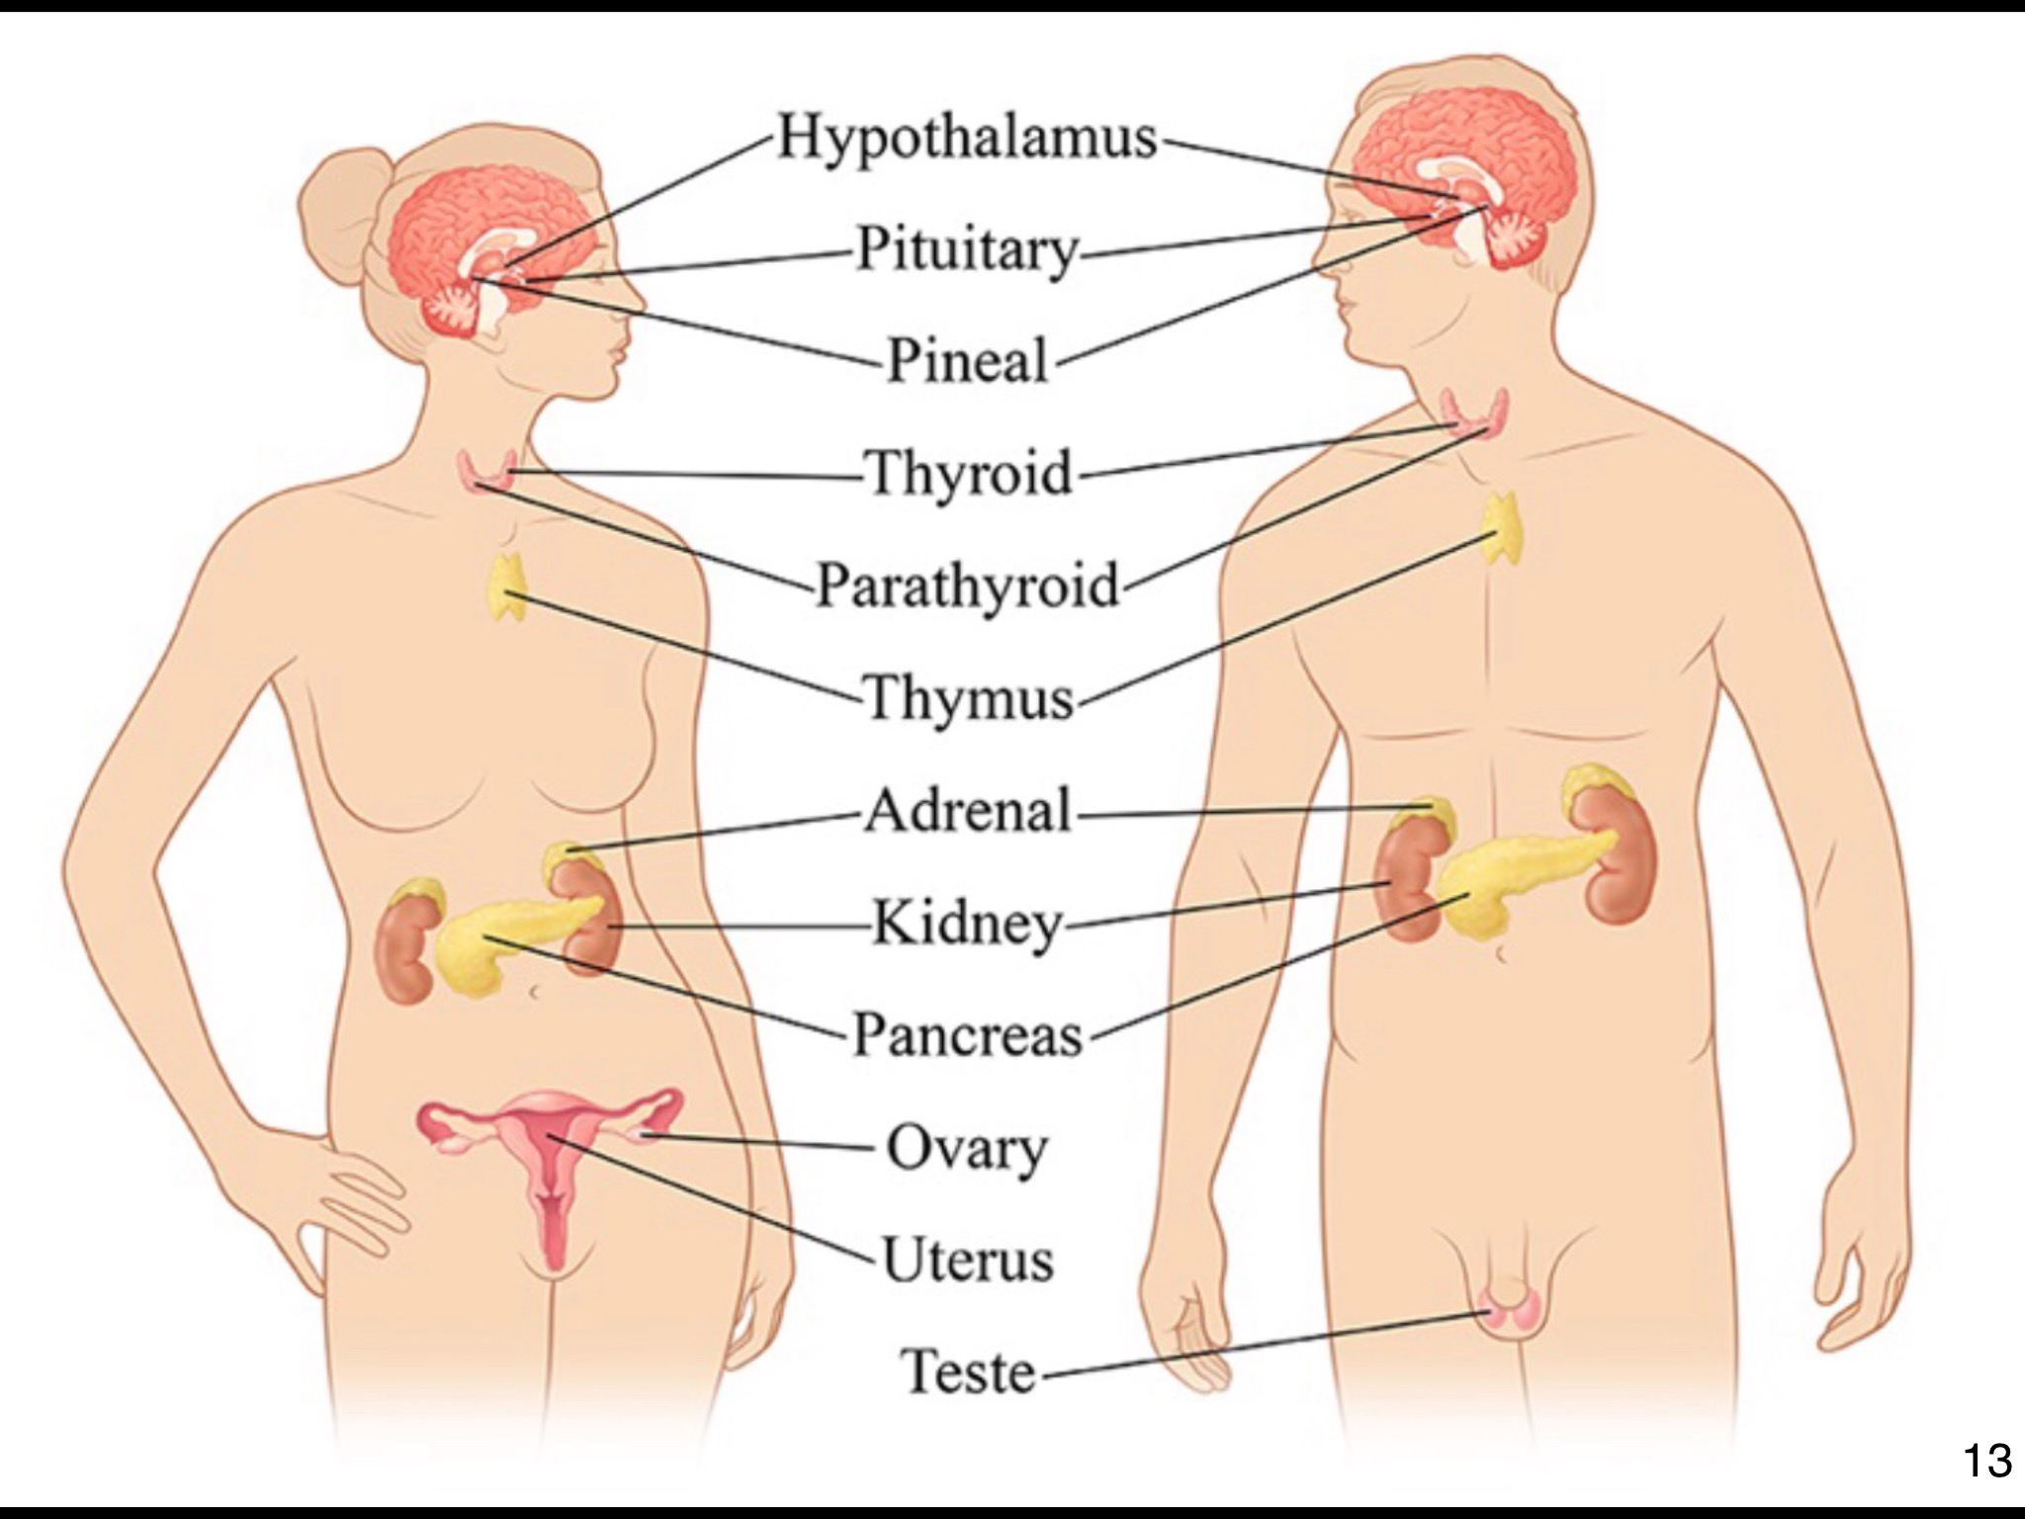

Slide 14
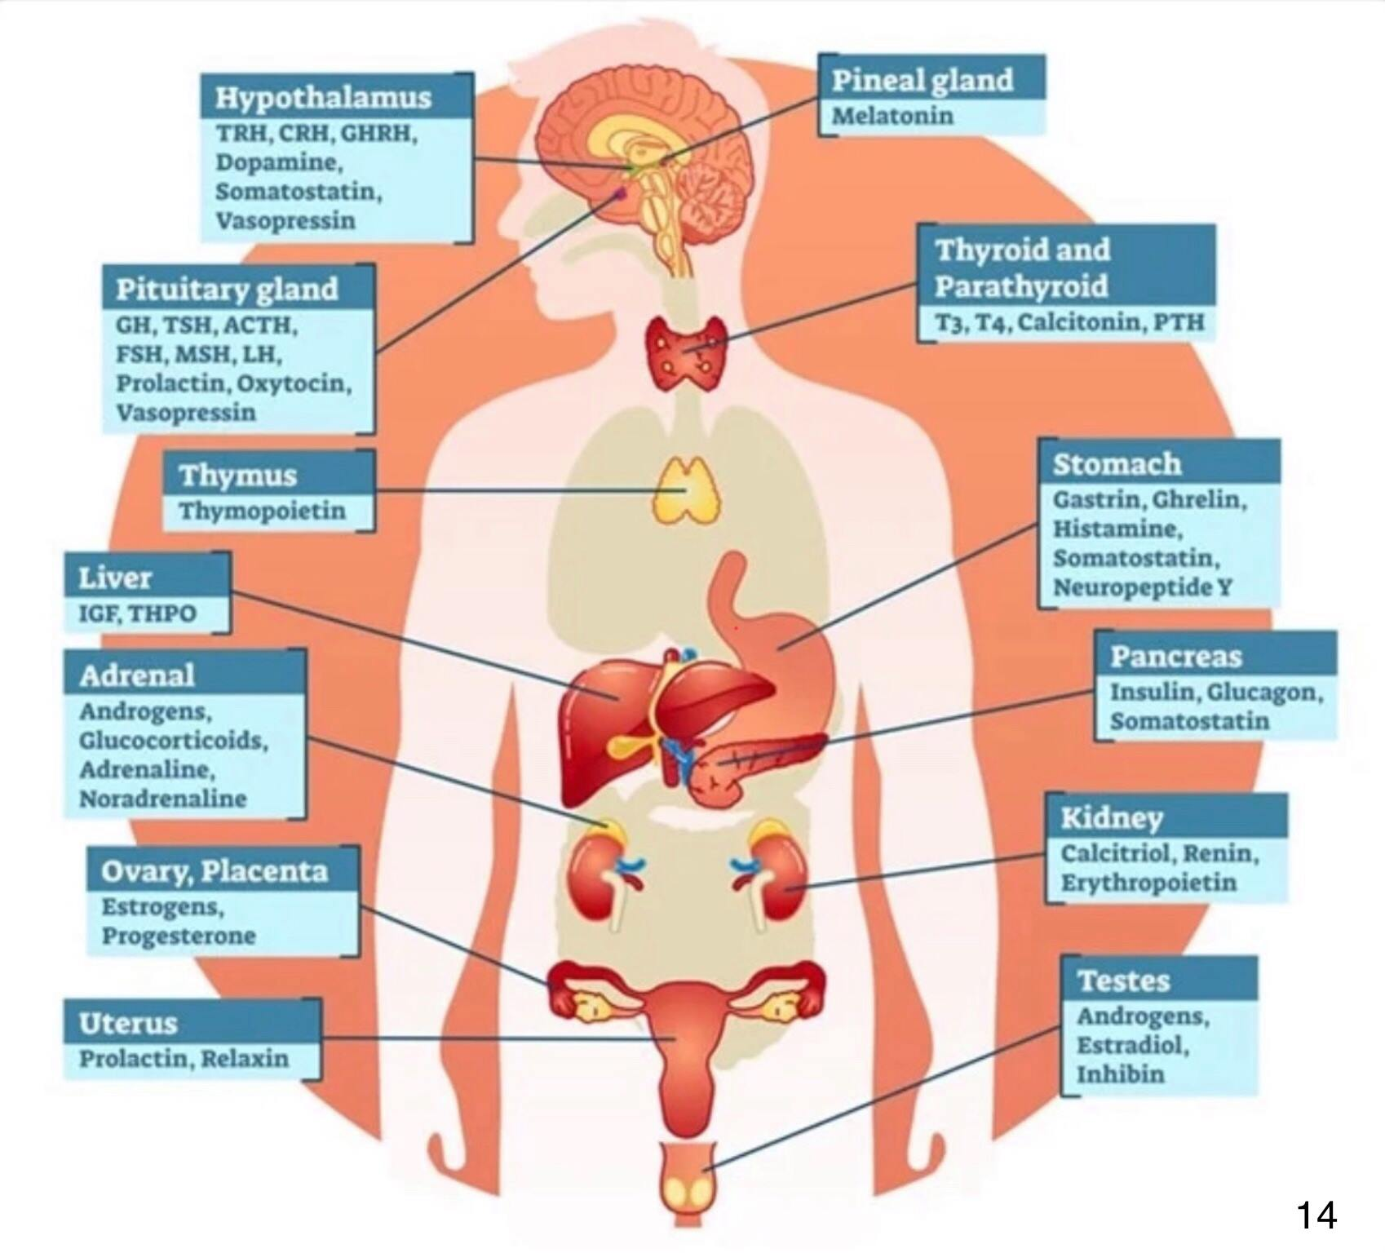

Slide 15
Stress: Definition
Stress is a significant problem of our times and affects both physical as well as the mental health of the people.
- World Health Organization (WHO)
Stress is a situation where the organism perceives a situation as threatening.

Slide 16
Good Stress vs Bad Stress
Stress is a part of our life Need to understand good stress and bad stress. It is important to understand the difference between good & bad stress that is manageable. Good stress lead to bad stress when someone can not control eg. Sleeplessness, cardiac arrest, brain hemorrhage, diabetes, depression, anxiety, so on.

Slide 17
Types of Stress
Acute Stress: short term stress
Episodic Acute Stress: on going stress
Chronic Stress: never ending stress

Slide 18
5 Types of Stress
1. Environmental Stress: eg. chemical in foods, electromagnetic radiation - WHO
2. Postural Stress: frequently moving
3. Emotional Stress: immune system & damage
4. Dental Stress: tooth decay and gum disease
5. Nutritional Stress: preservatives, pesticides and
over-eating

Slide 19
Causes of Stress
Main courses:
Person's Physical Response eg. Environment, Position so on
Person's Mental or Emotional Response e.g.
Covid 19 Pandemic

Slide 20
Stress Management Techniques
Short Term
(a) Physical: e.g. Walking, Jumping, Sports (swimming), Cycling, so on
(b) Therapy: Oxytherapy, Hydrotherapy, Aromatherapy related to 5 different Senses e.g. Nose, Ear, Eye, tongue, touch or skin.

Slide 21
Stress Management Techniques
2. Long Term
Vitamin D3 (Sunbathe)
Meditations & Physical Exercise or Yoga
Bond with pets e.g. Dog
Eating habit e.g. Vegetable
Naturopathy

Slide 22
Stress Management
Techniques:
Start from Kitchen: (a) microwave (b) can foot (c) plastic containers
Sunbathing ( Vitamins D3)
Hydrotherapy
Oxytherapy
Aromatherapy
Sound therapy
Visual therapy

Slide 23
Aromatherapy (Smell Sense)
The olfactory system (sense of smell) and the limbic system ( the brain net work associated with emotions and memories) are closely interact simultaneously in Aromatherapy. Lavender is commonly use but it depends upon individual to individual, one should use the aroma which he/she like most, e.g. some like Jasmine rather than lavender.

Slide 24
Hydrotherapy:
Use of water in the treatment of different conditions e.g. Arthritis, rheumatic including STRESS.

Slide 25
Oxytherapy:
94 - 96% of oxygen is recommended in most conditions. Air is normally 21% oxygen by volume while Oxytherapy increases this by some amount up to 100%. Oxygen is essential for normal CELL METABOLISM but excessive high concentrations can cause OXYGEN TOXICITY such as lung co damage, resulting RESPIRATORY FAILURE.

Slide 26
Visiotherapy :
Visiotherapy or Vision therapy work when the eyes and brain learn to work together as a team & improves the immune system to fight against the BAD STRESS. CHLOROPHYLL: Observing natural greenery in open environment is one of the best natural vision therapy.

Slide 27
Metabolism:
The chemical processes
that occur within a LIVING ORGANISM in order to maintain life.

Slide 28
Chemical reaction:
A process that involves RERRANGEMENT of the MOLECULAR or IONIC structure of a substance (living or non living), as opposed to a change in physical form.

Slide 29
CBT :
Cognitive-behavioural therapy (CBT): The treatment guidelines of 4 different Cognitive Behavioral Treatment for PTSD ( Post-Trumatic Stress Disorder):
EX (Exposure Therapy)
SD (Systematic Desensitization)
SIT ( Stress Inoculation Training)
CA (Combination Approach)

Slide 30
OCD (Obsessive - compulsive disorder):
OCD is a disorder in which people have unwanted thoughts, idea or sensation (obsessions) that make them feel driven to do something repetitively (compulsions).
OCD is a kind of “Anxiety Disorder”.
OCD: Example Repeatedly washing or cleaning hands. Repeatedly checking in on loved ones to make sure they're safe. Chemical and functional abnormalities in the brain are the cause. OCD is also due to hereditary and genetic factors.

Slide 31
Chlorophyll :
Chlorophyll absorbs toxins in intestines & the body, and acts as an internal deodorant: menstrual doors, bad breath, sweat, urine, stools, food doors (e.g. Garlic). 300 mg of chlophyllin (semi synthetic porphyrins derived from chlorophyll) per day, normal adult can consume.

Slide 32
Parasympathetic :
The combination or balance of O2 & CO2 in blood specially in brain ( Pituitary gland) is responsible for RELAXATION which is called “Parasympathetic”.

Slide 33
Oxidative Stress

Slide 34
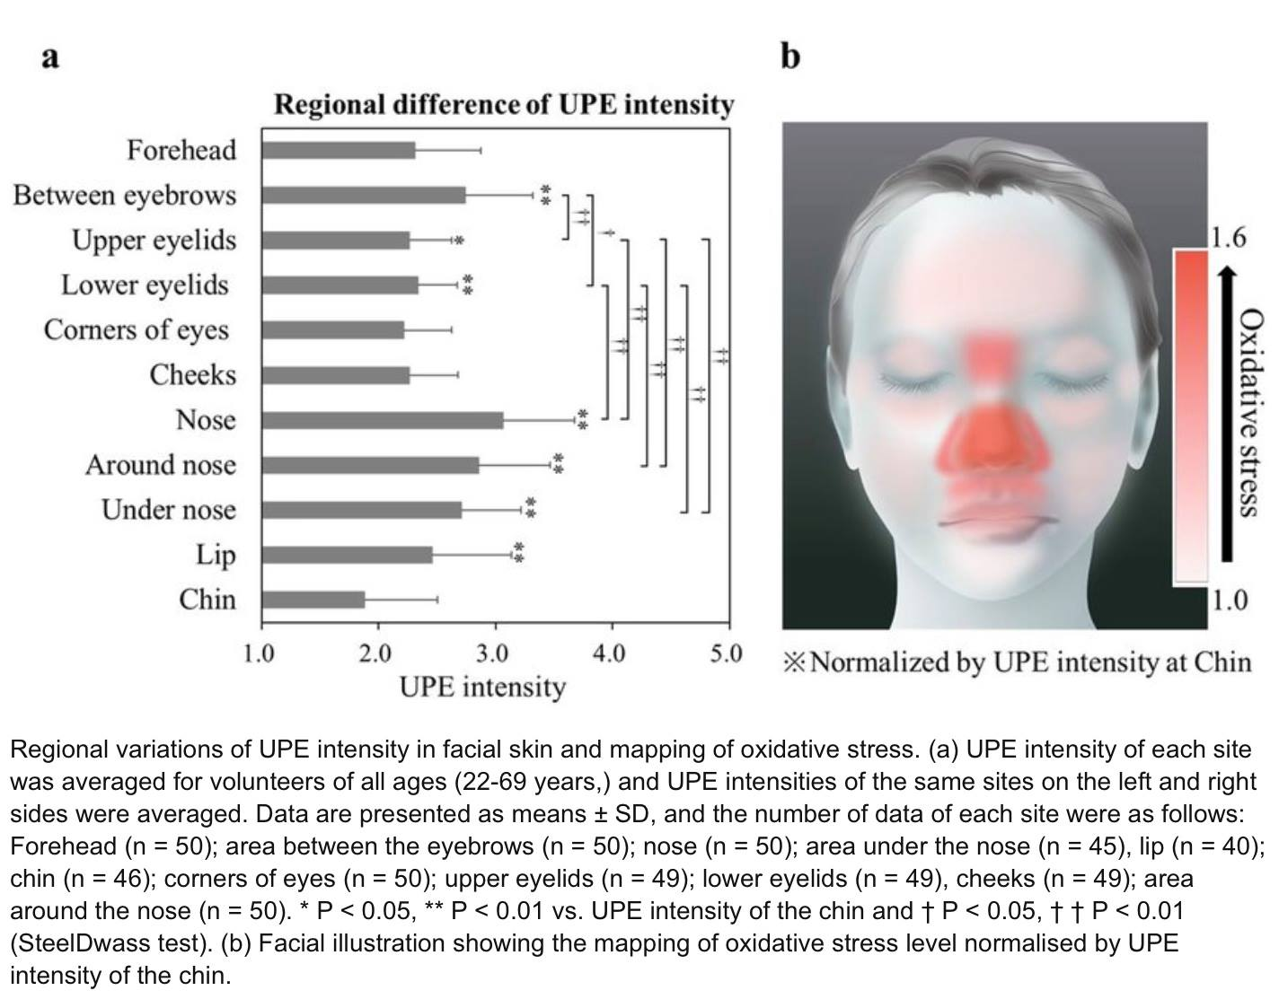
Chlorophyll :

Slide 35
Oxidative Stress:
Oxidative Stress is a phenomenon caused by imbalance between production and the accumulation of oxygen reactive species (ROS) in cells and tissues and the ability of a biological system of detoxify.

Slide 36
Oxidative Stress:

Slide 37
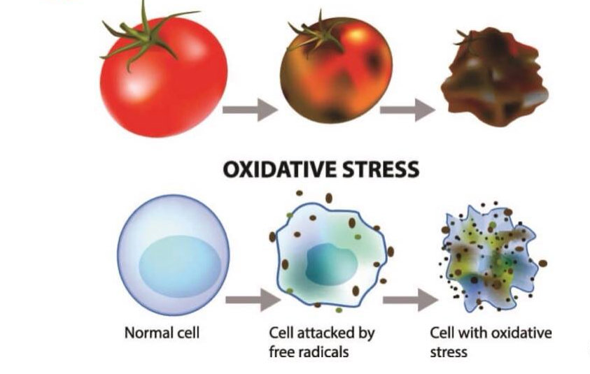

Slide 38
Endoplasmic Reticulum (ER) Stress:
ER Stress occurs when the capacity of the ER to fold proteins becomes saturated. ER stress also cause by mutations in protein.

Slide 39
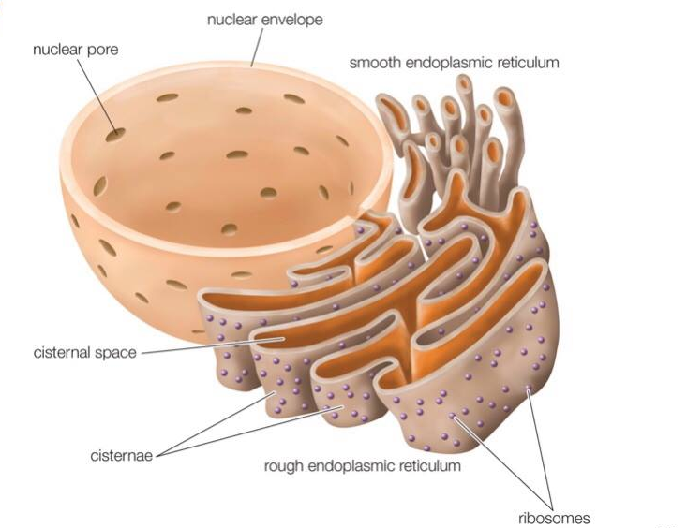
Endoplasmic reticulum

Slide 40
Protein:
Any of a class of nitrogenous organic compounds that consist of large molecules of one or more long chains of amino acid. Nitrogenous organic compounds that contain a Nitrogen atom. Amino acid is a simple organic compounds containing both a carbonyl (-COOH) and an amino (-NH2) group.

Slide 41
Venoms :
Venoms are complex compounds of PROTEINS & PEPTIDES that evolves from the glands (e.g. salivary) of living organisms. Peptides is a compound of two or more amino acids linked in a chain, the carbonyl group of each acid being joined to the amino group of the next by a bond
of the type -OC-NH

Slide 42
Summary:
COVID-19 and Stress are running parallel at present environment all over the world , needs to use our self management with our immune systems making strongly using our 5 different senses. Self awareness is one of the best tool to make strong our immune system.

Slide 43
Stress is part of
our LIFE
SEE YOU AGAIN

